Slide 1
Genre Writing
Lesson Objectives: To identify different genres of writing; to recognise the components of genre writing in examples ready to use in our own work.

Slide 2
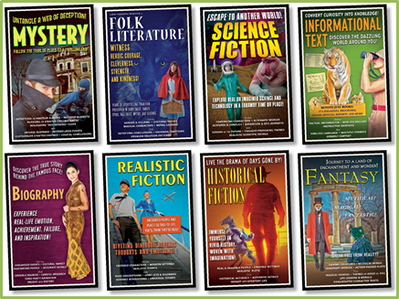
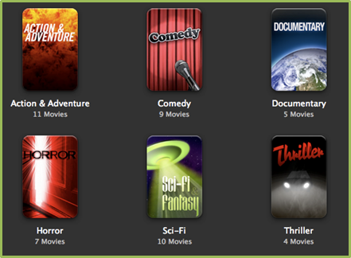
Look at the examples of different genres.
What do you think the term genre means?
Can you write a definition in your own words?

Slide 3
How many different genres of literature can you think of?

Slide 4
How many different genres of literature can you think of?
FANTASY
THRILLER
FICTION
SCIENCE FICTION
GOTHIC
TRAGEDY
MYSTERY
MYTH

Slide 5
ACTIVITY 1
You are going to see 3 examples of common literature genres.
Can you identify WHY they are that genre? Think about:
Setting
Character(s)
Description
Language (the words used)

Slide 6
October arrived, spreading a damp chill over the grounds and into the castle. Madam Pomfrey, the nurse, was kept busy by a sudden spate of colds among the staff and students. Her Pepperup potion worked instantly, though it left the drinker smoking at the ears for several hours afterward. Ginny Weasley, who had been looking pale, was bullied into taking some by Percy. The steam pouring from under her vivid hair gave the impression that her whole head was on fire.
Raindrops the size of bullets thundered on the castle windows for days on end; the lake rose, the flower beds turned into muddy streams, and Hagrid's pumpkins swelled to the size of garden sheds. Oliver Wood's enthusiasm for regular training sessions, however, was not dampened, which was why Harry was to be found, late one stormy Saturday afternoon a few days before Halloween, returning to Gryffindor Tower, drenched to the skin and splattered with mud.
Even aside from the rain and wind it hadn't been a happy practice session. Fred and George, who had been spying on the Slytherin team, had seen for themselves the speed of those new Nimbus Two Thousand and Ones. They reported that the Slytherin team was no more than seven greenish blurs, shooting through the air like missiles.
FANTASY
Can you identify WHY this piece of writing is in the fantasy genre?
Think about:
Setting
Character(s)
Description
Language (the words used)

Slide 7
October arrived, spreading a damp chill over the grounds and into the castle. Madam Pomfrey, the nurse, was kept busy by a sudden spate of colds among the staff and students. Her Pepperup potion worked instantly, though it left the drinker smoking at the ears for several hours afterward. Ginny Weasley, who had been looking pale, was bullied into taking some by Percy. The steam pouring from under her vivid hair gave the impression that her whole head was on fire.
Raindrops the size of bullets thundered on the castle windows for days on end; the lake rose, the flower beds turned into muddy streams, and Hagrid's pumpkins swelled to the size of garden sheds. Oliver Wood's enthusiasm for regular training sessions, however, was not dampened, which was why Harry was to be found, late one stormy Saturday afternoon a few days before Halloween, returning to Gryffindor Tower, drenched to the skin and splattered with mud.
Even aside from the rain and wind it hadn't been a happy practice session. Fred and George, who had been spying on the Slytherin team, had seen for themselves the speed of those new Nimbus Two Thousand and Ones. They reported that the Slytherin team was no more than seven greenish blurs, shooting through the air like missiles.
FANTASY
Alliteration: made up name. ‘Potion’ makes us think of magic.
Smoke coming from your ears isn’t possible. Impossible actions are magical/fantastical.
Normal objects growing to unnatural sizes.
Made up names of objects. Adds to the feeling of unusual/fantasy.
Simile: children able to fly! Definitely not a normal action.

Slide 8
It was a cold night. The room was dark except for the light coming from the landing, through an open crack of door. Alex, curled up in bed, was just getting warm enough to drop off to sleep. Outside, a car door slammed and an alarm chirupped as it was set. Much closer, something slithered inside the chimney.
Alex's eyes opened and stayed alert. He stiffened into stillness, and waited, and listened.
Inside the chimney, a voice muttered, annoyed. Something scratched and slipped on the brickwork. Old dust and soot spattered into the grate.
Alex snatched a breath to shout, but then held it. If he made a noise, whatever was coming down the chimney would know he was there, and exactly where to find him. If he kept quiet, maybe it would think the room was empty and go away.
THRILLER
Can you identify WHY this piece of writing is in the thriller genre?
Think about:
Setting
Character(s)
Description
Language (the words used)

Slide 9
It was a cold night. The room was dark except for the light coming from the landing, through an open crack of door. Alex, curled up in bed, was just getting warm enough to drop off to sleep. Outside, a car door slammed and an alarm chirupped as it was set. Much closer, something slithered inside the chimney.
Alex's eyes opened and stayed alert. He stiffened into stillness, and waited, and listened.
Inside the chimney, a voice muttered, annoyed. Something scratched and slipped on the brickwork. Old dust and soot spattered into the grate.
Alex snatched a breath to shout, but then held it. If he made a noise, whatever was coming down the chimney would know he was there, and exactly where to find him. If he kept quiet, maybe it would think the room was empty and go away.
THRILLER
Uncomfortable verbs: gives the story a very unhappy feeling.
Triple of verbs: character is acting quickly, but also doing very little. Makes the story appear tense.
A voice in an unusual place, and without a specific body. This is supposed to be frightening.
Metaphor: shows how panicked Alex is. Makes his action appear rushed and desperate. He is scared.

Slide 10
But very early in the morning poor Ogilvy, who had seen the shooting star and who was persuaded that a meteorite lay somewhere on the common between Horsell, Ottershaw, and Woking, rose early with the idea of finding it. Find it he did, soon after dawn, and not far from the sand-pits. An enormous hole had been made by the impact of the projectile, and the sand and gravel had been flung violently in every direction over the heath, forming heaps visible a mile and a half away. The heather was on fire eastward, and a thin blue smoke rose against the dawn.
The Thing itself lay almost entirely buried in sand, amidst the scattered splinters of a fir tree it had shivered to fragments in its descent. The uncovered part had the appearance of a huge cylinder, caked over and its outline softened by a thick scaly dun-coloured incrustation. It had a diameter of about thirty yards. He approached the mass, surprised at the size and more so at the shape, since most meteorites are rounded more or less completely. It was, however, still so hot from its flight through the air as to forbid his near approach. A stirring noise within its cylinder he ascribed to the unequal cooling of its surface; for at that time it had not occurred to him that it might be hollow.
SCIENCE FICTION
Can you identify WHY this piece of writing is in the science fiction genre?
Think about:
Setting
Character(s)
Description
Language (the words used)

Slide 11
But very early in the morning poor Ogilvy, who had seen the shooting star and who was persuaded that a meteorite lay somewhere on the common between Horsell, Ottershaw, and Woking, rose early with the idea of finding it. Find it he did, soon after dawn, and not far from the sand-pits. An enormous hole had been made by the impact of the projectile, and the sand and gravel had been flung violently in every direction over the heath, forming heaps visible a mile and a half away. The heather was on fire eastward, and a thin blue smoke rose against the dawn.
The Thing itself lay almost entirely buried in sand, amidst the scattered splinters of a fir tree it had shivered to fragments in its descent. The uncovered part had the appearance of a huge cylinder, caked over and its outline softened by a thick scaly dun-coloured incrustation. It had a diameter of about thirty yards. He approached the mass, surprised at the size and more so at the shape, since most meteorites are rounded more or less completely. It was, however, still so hot from its flight through the air as to forbid his near approach. A stirring noise within its cylinder he ascribed to the unequal cooling of its surface; for at that time it had not occurred to him that it might be hollow.
SCIENCE FICTION
Space vocabulary: immediately tells us that this is otherworldly.
This section describes the enormous power of the object. The fact it has sent ‘sand and gravel’ miles away shows how heavy it is. It is also described as a ‘projectile’ and a ‘Thing’ suggesting we don’t know what the object actually is.
Triple adjectives: the object doesn’t seem from earth. It is unusual to describe something from space as ‘scaly’.
Strange noise from within the object makes it seem even more otherworldly; supposed to disturb us and make us feel tense.

Slide 12
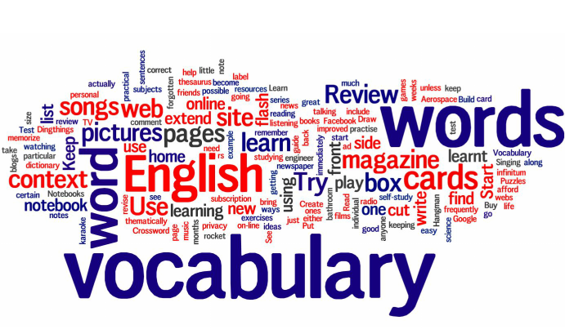
ACTIVITY 2
There are going to be 2 vocabulary activities on the next slides.
You might choose to do just 1 or both of them depending on how confident you feel.

Slide 13
2a) You are going to create a series of vocabulary clouds. Look at the first example and then have a go at creating your own using a word from the ‘Vocabulary Vault’.
Disastrous
Vocabulary Vault
Scary
Happy
Strange
Evil
Angry
Red
Dark
Horrible
Terrible
Bad
Grim
Diabolical
Appalling

Slide 14
2a) You are going to create a series of vocabulary clouds. Look at the first example and then have a go at creating your own using a word from the ‘Vocabulary Vault’.
Vocabulary Vault
Scary
Happy
Strange
Evil
Angry
Red
Dark

Slide 15
2a) You are going to create a series of vocabulary clouds. Look at the first example and then have a go at creating your own using a word from the ‘Vocabulary Vault’.
Vocabulary Vault
Scary
Happy
Strange
Evil
Angry
Red
Dark

Slide 16
2b) Below are some examples of ambitious vocabulary with their definitions all muddled. Can you work out which word matches to which definition?
Lacerate |  | To strike repeatedly.
Pummel |  | Not friendly; distant.
Benevolence |  | Having or displaying a passionate intensity.
Exhilaration |  | A feeling of pensive sadness, typically with no obvious cause.
Aloof |  | To tear or make deep cuts in.
Melancholy |  | The feeling of excitement, happiness or elation.
Fervent |  | Feeling or showing sympathy and concern for others.
Compassionate |  | The quality of being well meaning/kind.

Slide 17
2b) Below are some examples of ambitious vocabulary with their definitions all muddled. Can you work out which word matches to which definition?
Lacerate |  | To strike repeatedly.
Pummel |  | Not friendly; distant.
Benevolence |  | Having or displaying a passionate intensity.
Exhilaration |  | A feeling of pensive sadness, typically with no obvious cause.
Aloof |  | To tear or make deep cuts in.
Melancholy |  | The feeling of excitement, happiness or elation.
Fervent |  | Feeling or showing sympathy and concern for others.
Compassionate |  | The quality of being well meaning/kind.

Slide 18
ACTIVITY 3
Using everything you have gained from the previous activities, it is now your turn to create a piece of creative writing.
Maybe think about the following things:
Choose which genre you would like to write in.
Choose some strong vocabulary (use the banks to help you if you like)
Make it as detailed, unique and exciting as you can!
Aim for a maximum of 2 A4 sides.

